Slide 1
A Combined CNN and lstm model for arabic sentiment analysis
Students :
Fida Khoury
Khalil Diabes
Milad Irhayil

Slide 2

Introduction
Sentiment analysis - a form of text analysis
This typically involves taking a piece of text whether its sentence, a comment or an entire document returning a “score” that measures how positive or negative the text is.
We want sentiment classification for short text messages from twitter in the Arabic language .
Arabic – A rich language in morphology.
*Complexity increases*
عادي
سلبي
ايجابي

Slide 3
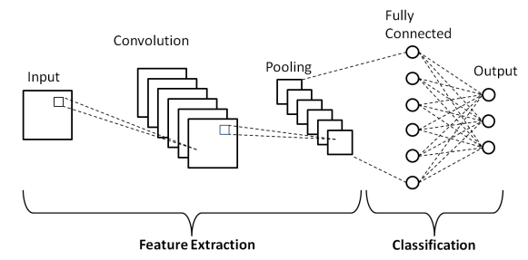
Convolutional Neural network- Cnn
CNN is a class of neural network, like any other neural network it has layers.
CNN’s are regularised versions of multilayer perceptrons, to require minimal preprocessing .
And multi perceptron usually mean fully connected networks.

Slide 4
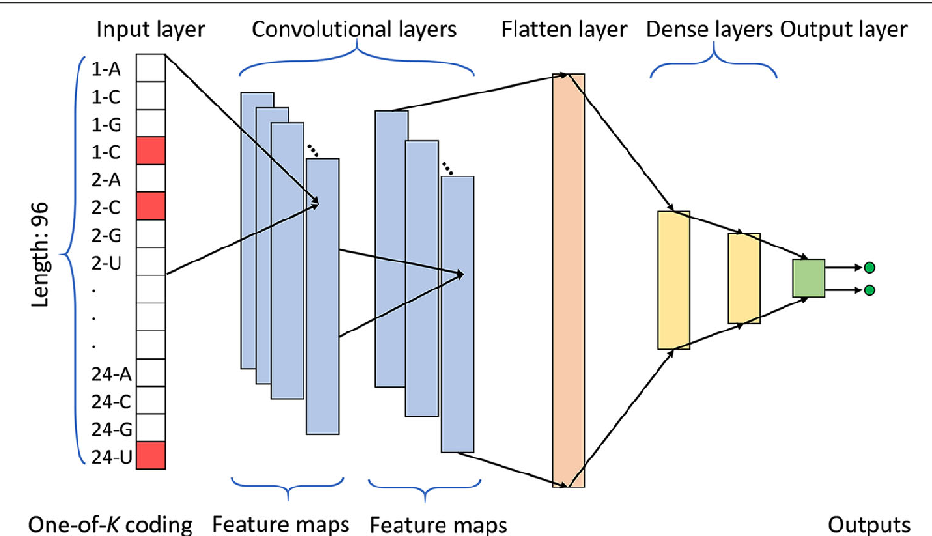
Cont.
Usually we apply CNN to image data (and other) which is 2d input data .
In our case when going to have 1d input data because it’s text classification .

Slide 5
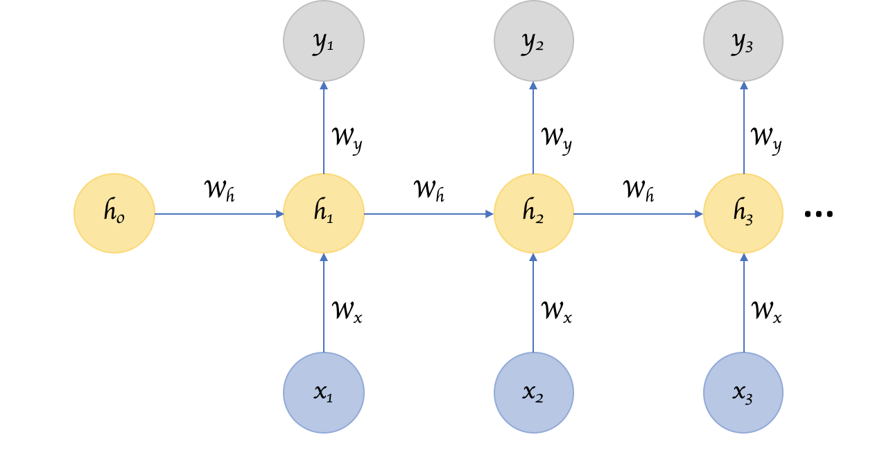
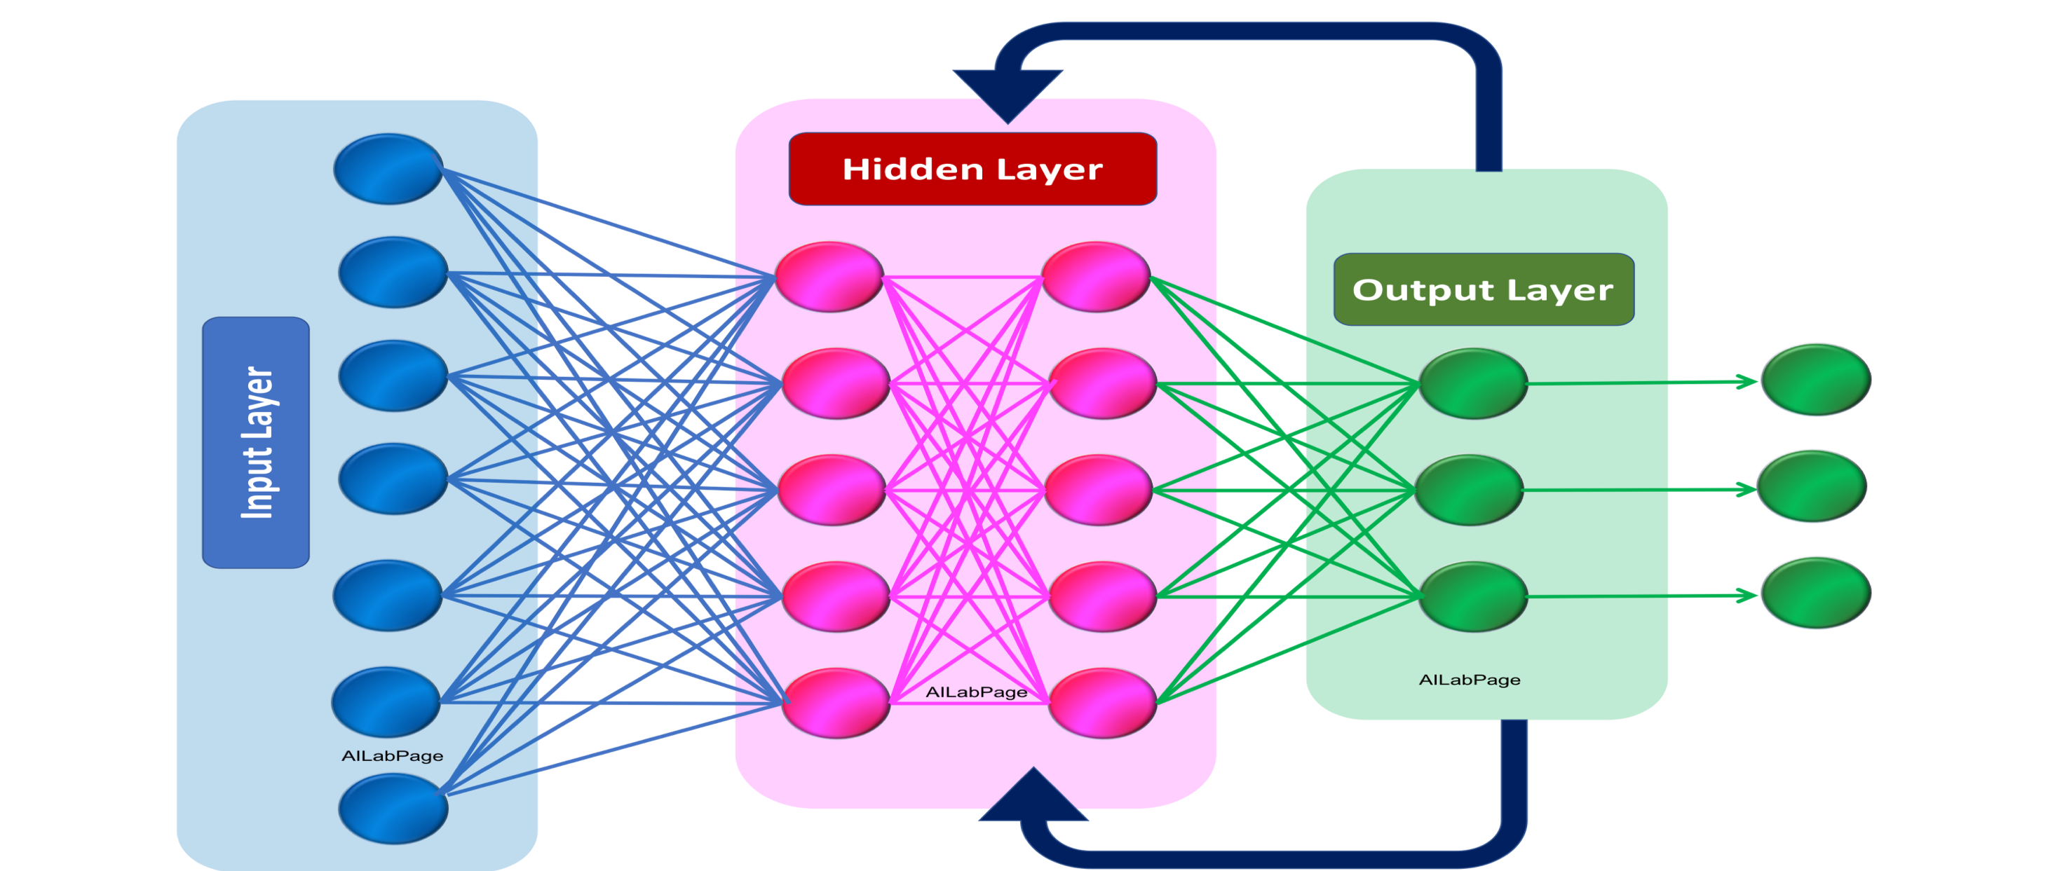
Recurrent Neural Network (RNN)
This is a kind of Neural Networks, where the output from previous step are fed as input to the current step.

Slide 6
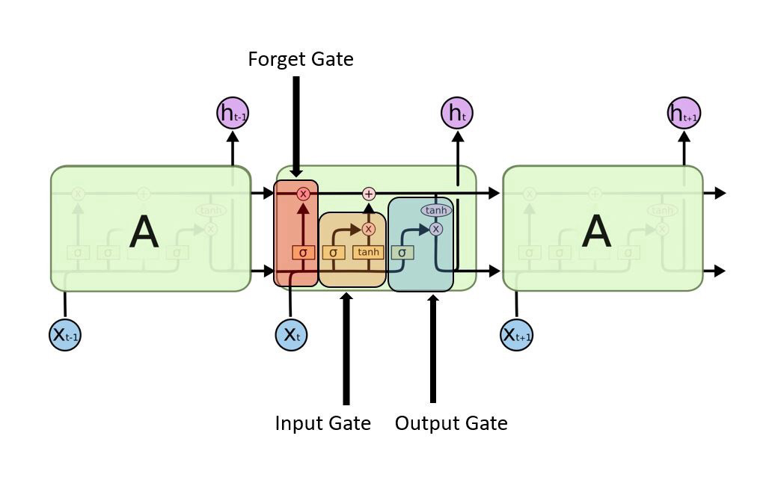
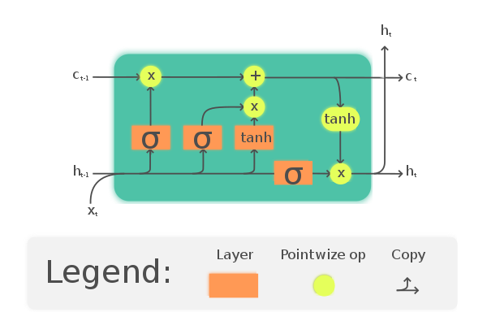
Long short memory term - lstm
LSTM is an artificial recurrent neural network.
LSTM networks are well-suited to classifying, processing and making predictions for sequential patterns.
In an LSTM network, three gates are present:

Slide 7
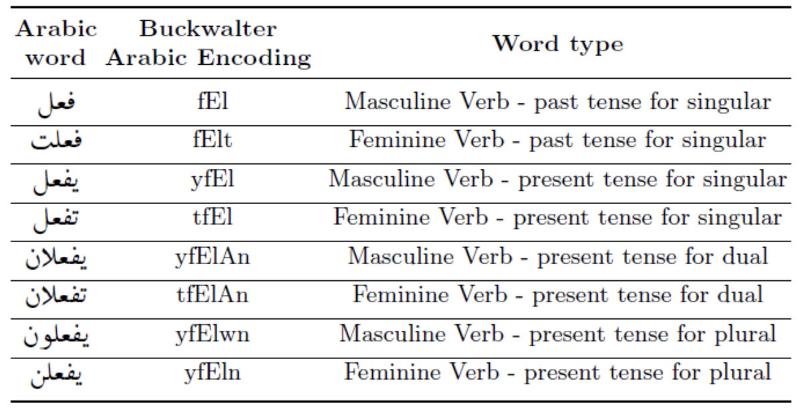
Arabic
Many forms for a single word in Arabic.
Rich in word and meanings.
Limited research available in this area.

Slide 8
The combination between Cnn and lstm on arabic
CNN’s has a very good feature learning .
Example on stages of feature learning on texts :
Character ➔ word ➔ word group ➔ clause ➔ sentence ➔ story .
LSTM have a great capabilities in learning data series by considering the previous output.

Slide 9
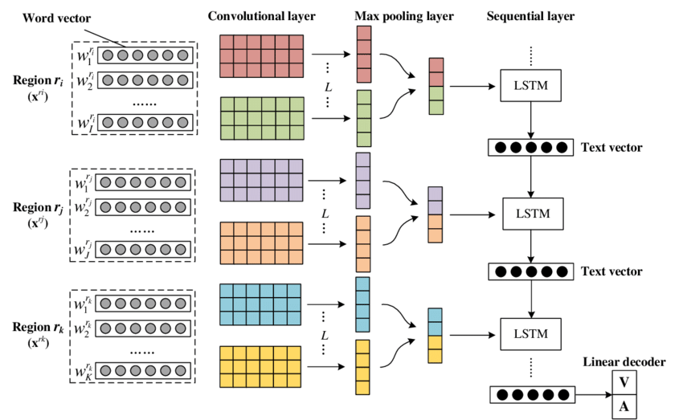

Slide 10
The Proposed Model

Slide 11
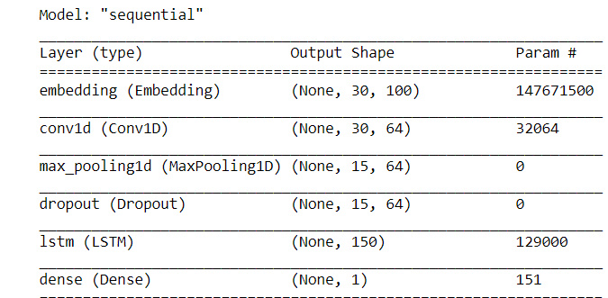

Slide 12
overview
Gather as much as possible relevant data that apply to the project requirements.
Clean the data and use embedding layers along side with word to vector models to convert it to numeric data.
With CNN filters provoke the machine learn the data features for the data.
Execute max-pooling layer to get a representer of the maximal (relevant) features.
Now we have to drop the redundant data, to prevent overfitting and also makes our machine act as if its taking the consensus over an ensample of networks, witch is a good way to improve performance.
Use the LSTM layer to make predictions with considering repeated or sequential patterns from previous states.
With the dense layer we can get the output based on a sigmoid function
Notes:
consensus, or agree on some data value that is needed during computation.
. ensample(Noun) An example; a pattern or model for imitation.
ensample(Verb) To exemplify, to show by example.

Slide 13
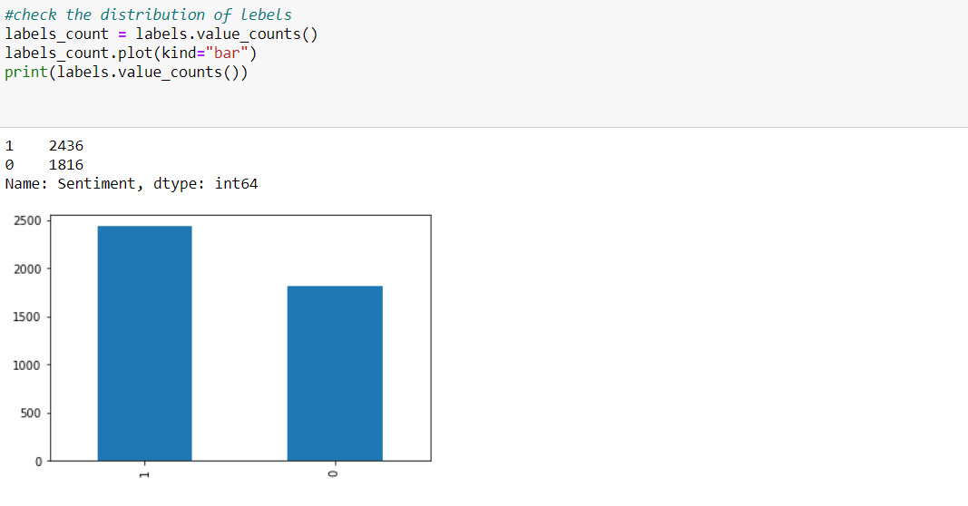
Import data
The data is ana Arabic tweets labeled text from tweeter in Saudi Arabia the text is labeld to 2 labels
Positive and negative (positive=1,negative=0)

Slide 14
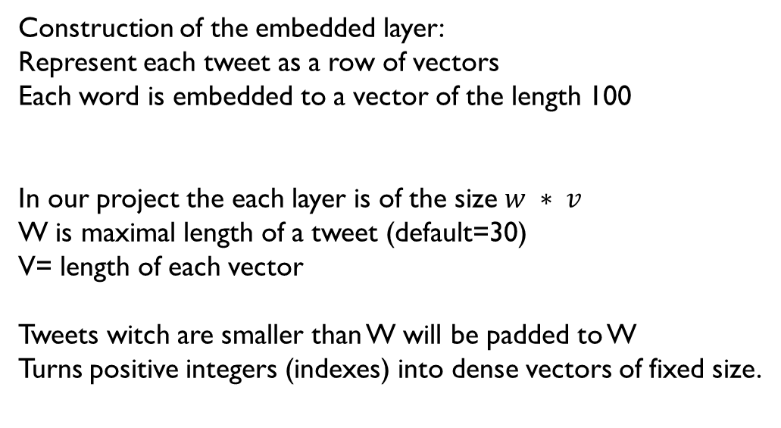
Embedded layer
Embedded layers
الخدمات
بشكل
عام
الصحية
<PAD/>
جيدة
<PAD/>
<PAD/>
Construction of the embedded layer:
Represent each tweet as a row of vectors
Each word is embedded to a vector of the length 100
In our project the each layer is of the size $w ∗ v$
W is maximal length of a tweet (default=30)
V= length of each vector
Tweets witch are smaller than W will be padded to W
Turns positive integers (indexes) into dense vectors of fixed size.

Slide 15
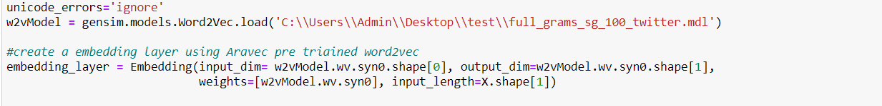
Embedded layer
Loading the word to vector model
Constructing the embedding layer with the word to vector
Input dim: size of the vocabulary, how many columns in the embedded matrix.
Output dim: Dimension of the dense embedding, how many rows in the embedded matrix.
Weights: array essentially holds raw word-vectors.
From the perspective of the neural-network used to train word-vectors.
Every word will have a vector.

Slide 16
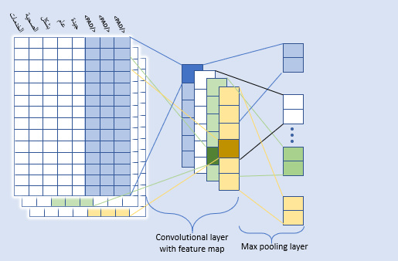
CNN
In the CNN we are trying to get the data best features so we apply these steps:
Scan the vector sequence with the help of the fixed filters(Filters=64).
The filter interact with the matrix and results a matrix of features (features map) computed using RELU activation function.
We apply the max-pooling layer to minimize the size of the matrix
to prevent computation in the advanced layer
and to capture most important features.

Slide 17
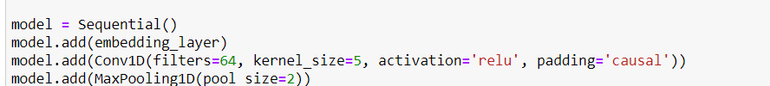
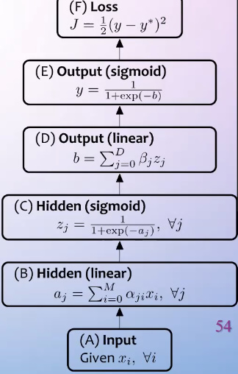
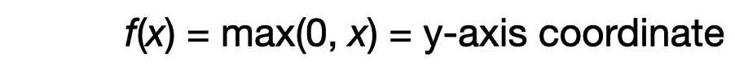

CNN
CNN with 64 filters, and a kernel matrix size of 5,
We also used the RELU activation function,
Our general purpose is to learn the features.
With every data cell we update the weights of
The features until its stable.

Slide 18
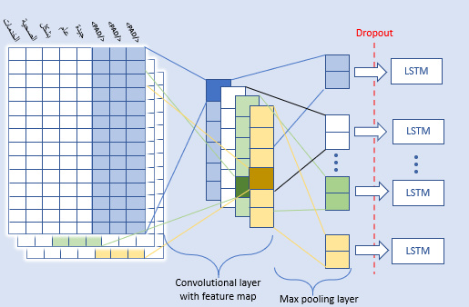
dropout
When we do the learning progress there is a big chance for getting trapped in a overfitting situation
Therefore we apply the dropout strategy for some output layers and randomly ignore them.(Dropout=0.5)

Slide 19
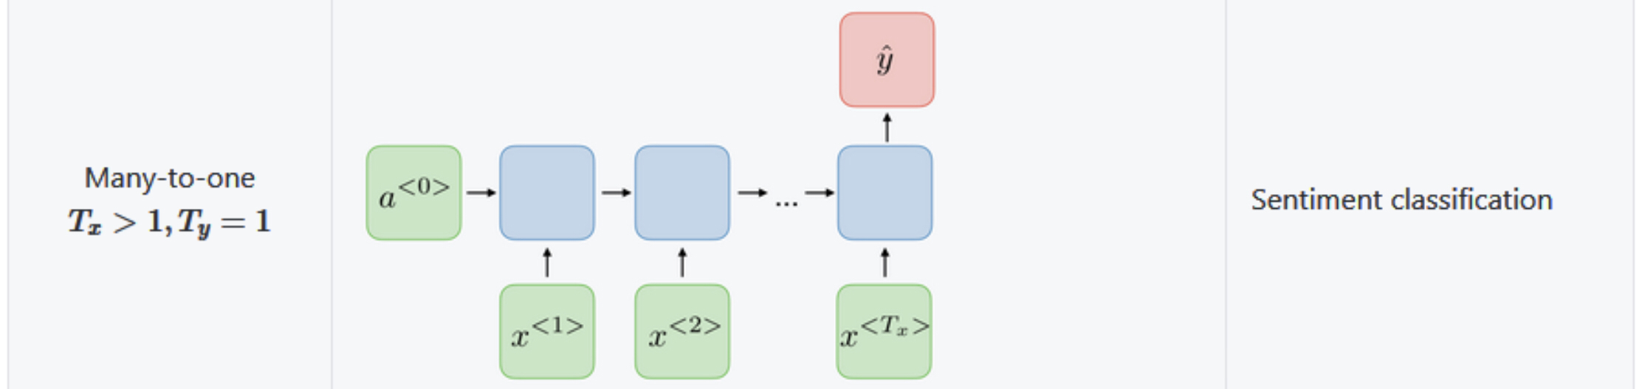
LSTM long short term memory
Calling the model.add(LSTM (untis =lstm_out))
Units is the dimensionality of the output space.

Slide 20
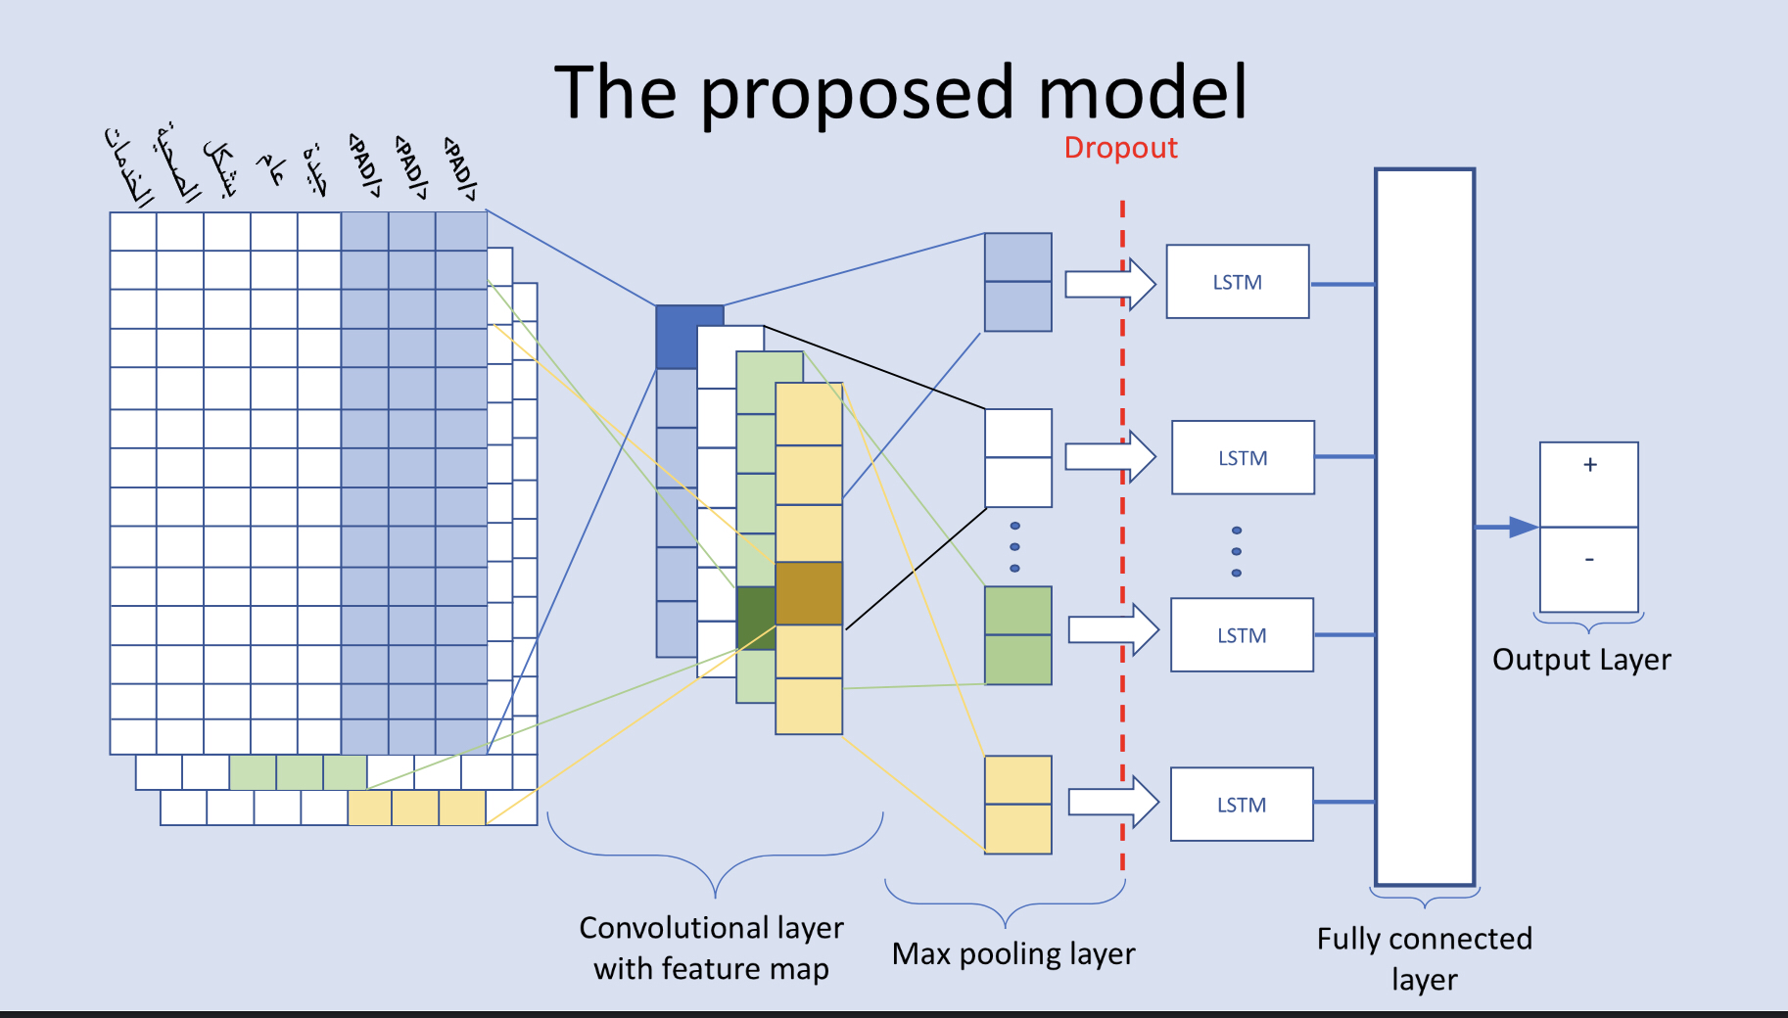
Dense / fully connected layer
Calling model.add(Dense (1, activation=‘sigmiod’))
The first parameter is the output size .
The second parameter is the activation function which is the sigmoid function .
The dense layer is a neural network layer that is connected deeply.

Slide 21
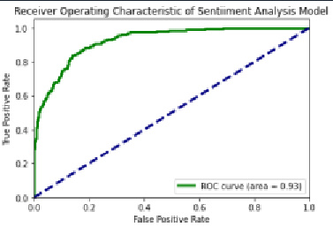
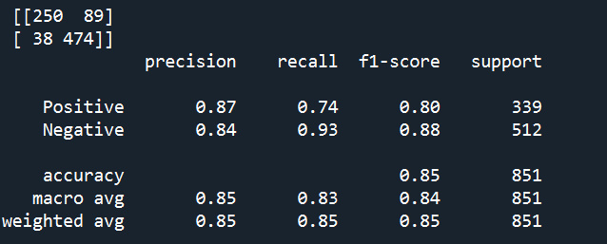
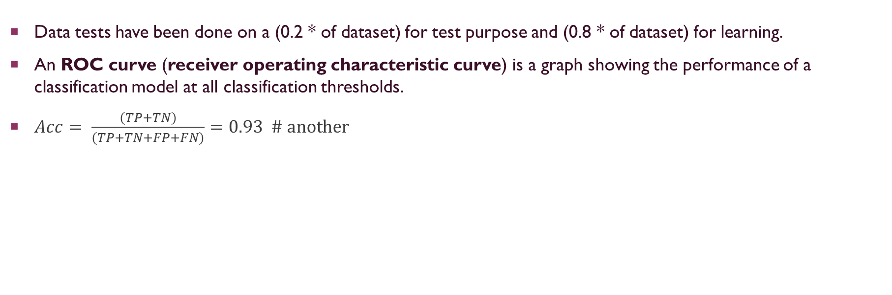
complexity
Data tests have been done on a (0.2 * of dataset) for test purpose and (0.8 * of dataset) for learning.
An ROC curve (receiver operating characteristic curve) is a graph showing the performance of a classification model at all classification thresholds.
$Acc= \frac{(TP+TN)}{(TP+TN+FP+FN)}=0.93 \# another$

Slide 22
summary
We have achieved the project goal by implementing simple but helpful techniques to our project.
That was our presentation thank you.
Now its time for Q&A.

